Slide 1
SWEET YEARS

Slide 2
ENJOY YOUR FREE TIME L o l
Teacher tells students: “The one who answers the next question can go home”
Perica stands up throws the chalk on the board.
Teachers says: “Who did that”?
Perica says: I did, can I go now?
Boy is speaking with the girl: “We’re breaking up”!
“Why”?, the girl asks.
We don’t have nothing in common.
“Yes, we do”, she says, "We have 300 facebook friends”

Slide 3
Josh and David were taking a wardrobe on the 10th floor and in one moment Josh says:
“Ok David, I have one good and one bad news”.
“Tell me first the good one”, says David.
“The good one is that we are on the ninth floor, but the bad one is that we are in the wrong building”.
Teacher: “Sam, what is the outside of tree called”?
Sam: “I don’t know”.
Teacher: “Bark Sam, bark”!
Sam: WOW, WOW, WOW

Slide 4
SPORT PAGE
CRISTIANO RONALDO
Cristiano Ronaldo played in Manchester United. Currently he plays in Real Madrid.
He was born on the Portuguese Island called Madeira.
His name was very rare in his country. He was named by the former president of U.S. Ronald Regan.
He started playing football when he was three years old.
Влада Тонтић

Slide 5
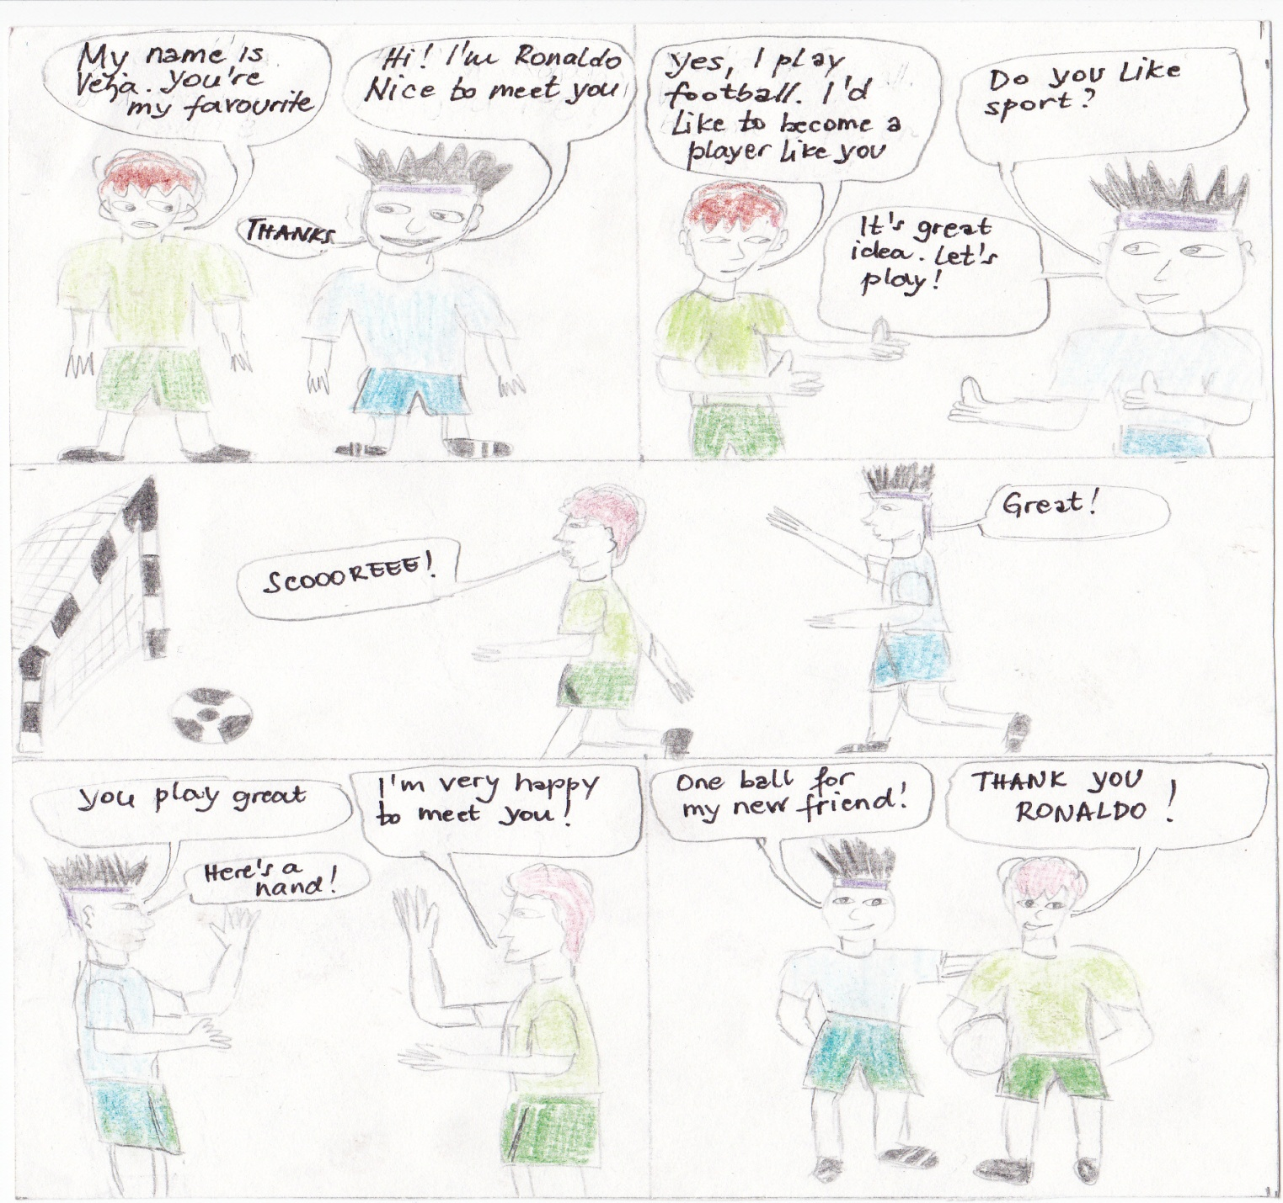

Slide 6
HANDBALL
Handball is team sport with a ball in which two teams compete with 7 players (6 field players +1 goalkeeper) per team. The game lasts 60 minutes divided into two halftimes, and the goal is to provide more goals then your opponent. Players add the ball to each other as they do in basketball but with a slightly smaller ball with different rules. Modern handball is usually played indoors while outdoors there are large variations in the forms of handball. The aim of the game is to score by hitting the ball to the opponent’s goal. And the team that scores more goals wins. The ball goes from player to player and player in best position should score. Each player can only make tree steps while holding the ball and when the ball touches the floor it must be added to a team-mate. Dimension of handball court is 40x20.
Anastasija,Natalija,Tijana,Ivana i Marina

Slide 7
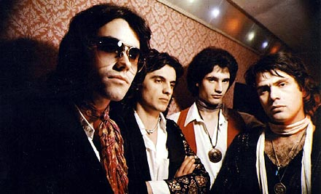
MUSIC MAKES MY SOUL DANCE
"Riblja corba" is the most popular rock band in this region.
Band "Riblja corba" was formed in Belgrade in 1978.
Bora Đorđević , the frontman of this famous band was a member of a group "Suncokret" in which a few well-know people took part as well. There were Gorica Popović,Nenad Božić,Snežana Jandrlić,Bilja Krstić and Bata Sokić.
Band"Riblja corba" was officially started with its work in resturant "Šumanovac" on 15th Avgusta 1978. First name of the band should ‘ve been "Bora and warriors" but then they have changed their mind sand named it "Riblja corba".
First concert happened in a village Elemir 26th avugsta 1978. After that they played all around the country.
They released their allbum in Decemer 22th called "Lutka sa naslovne strane" and "On i njegov BMW"it immedately became very popular.
Kristina Hagelkris

Slide 8
The last song about you
At the end of 70’s of 20th century
I was something of a man
I ‘ve been dead since that day
When there was three of us in the room
And my funeral.
And again, I promise to myself
But I know I lie within myself
That I ‘ll cease to remember
This is the last song about you
Translated by Kristina Hagelkris

Slide 9
FILM…..OUR SUGGESTIONS
LAJANJE NA ZVEZDE
The film takes place in a small town in Serbia in 1963. The heroes of these fanny story are students and teachers of one big school in a village .Their adventures are known and close to anyone who has an idea about high school life.
The hero Mihailo Knezevic with his spirit, intelligence and knowledge rises above all the rest. But he has one problem. School knowledge is not the problem, his problem is the girl from his class. His main rival is his brother who is in a relationship with the girl Mihailo loves.
There is also one student whom the P.E teacher prepares for the box match . All students believe in him but at the end he comes back from the match all bruised and humiliated. However, he remains their hero!
There is also a nervous principal that does not know who is more impossible to work with , pupils or teachers".
All in all the film is very funny and we belive you should watch it !
Zorana, Natalija, Ana,Nikolina, Stefan

Slide 11
Gossip Girl by Kristina Hagelkris
Gossip Girl is an American teen drama based on the book of the same name. The series begins with a return of Upper East Side “it” girl Serena Van Der Woodsen from mysterious stay at boarding school in Cornwall, Connecticut.
In series there is also a girl called Blair Waldorf, who plays the role of Serena’s best friend. Her nickname is “Queen B”.
The story also follows Chuck Bass, the bad boy of the Upper East Side.
“Golden boy” Nate Archibald, Chuck’s best friend and Blair’s boyfriend for many years.
Other characters of the turbulent Manhattan scene are: Dan Humpherey,Dan’s best friend Vanessa Abrams, and Dan’s sister, Jenny humphrey.
Each episode starts with the homepage of the gossip girl website with Serena’s photo from the pilot episode. The opening scene begins with:” Gossip Girl here, your one and only source into the scandalous lives of Manhattan's elite”, and ends up in whispered voice of Gossip girl saying "And who am I? That’s a secret I ‘ll never tell. You know you love me……Gossip Girl”.

Slide 12
My favourite band ONE DIRECTION
Memebers of this band are Niall,Louis,Zayn, Liam and Harry. All of them took part in the famous reallity show “American’s got a Talent”. The members of the jury suggested them to form a band and they accepted this idea.
Since then, they have been very popular all around the world, especially in America.
Interesting things about the band:
Lion and Zayn have got pets. Liam has got a puppy, the labrador whose name is Brit, because “One Direction” won The Brit Award in for 2012.
Zayn’s sharpei ‘s name is Boris ☺
Zayn’s name is pretty awkward. It is of Arabian origin and it menas “beautiful”. It suits him.
Anđela Parenta

Slide 13
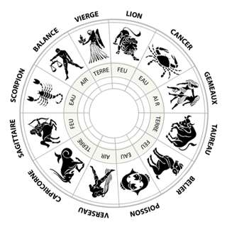
Horoscope
Aries You spend a lot of time at work. You need rest. This month you will be lucky in love.
Taurus
You expect a lot of obligation, but all of them will be fun. At school you don't have luck, as well as in love.
Gemini
You will be happy, because you’ll finish one job. You expect big love, but be careful.
Cancer
At work, you ‘ll accomplish big gains. Beware of a lion.
Lion
You will be in a bad mood. You will have negative energy, and so the people around you will be nervous.
Better luck at the end of a month.
Virgo
You're full of happiness. So this month you will be doing only good things.
Libra
This will be a difficult period. But you're very lucky in love, one lion is waiting for you .
Scorpio
You’ll be in good mood, and always ready to joke. In the middle of the month you expect a loss of money.
But it'll pass quickly.
Sagittarius
This month is the best period of the year for you. You expect just good things. Lucky in love, win money...
Capricorn
Expect hard days. Be strong, because always after the rain comes a rainbow.
Aquarius
This will be the best week of the month. You will be happy and satisfied.
Pisces
Pay attention to health, because you’ll probably catch a cold at the end of this month.
Zeljana Sekicki

Slide 14
Richard fell in love
A teacher was looking at a boy every morning , watching the his behavior and seeing that he was not focused in class.
Teacher: Hey Richard, are you ok? Richard: I’m fine.
The next morning, the teacher noticed that Richard was really not good. Teacher decided to call his parents.
Richard ‘ s parents came to school and talked to teacher.
Teacher: Mrs. Nicole, I invited you to school because of the behavior of your son. Nicole: Well, I want to listen you. Teacher: I would ask you to speak with your son.
After 15 minutes, Mrs. Nicole left school and went home. Richard was sitting in his room and heard his mum’s sharp voice. Richard was scared when his mum come up the stairs.
Nicole: Please sit next to me, we have something important to discuss. Your teacher told me about your strange behavior and the lecture. Please tell me what is going on. Richard: Mum I did not know how to tell you but I think it is the right time for that. I fell in love with girl. Her name is Isabella. Mom: Well, I give you one more chance, but you have to be careful at school.
. Richard improved at school. Mum was pleased with his success. After two days Mrs. Nicole called Isabella’s mom.
Nicole: Good day Mrs. Helena, I wanted to ask you if you want to go for a walk by the Lake on Sunday. Helena: Ok, should we take our children? Nicole: Yes, of course.
On Sunday afternoon the families went for a walk near the Lake. It was a very nice day for Richard and Isabella
Rachel: I’m very happy today. Isabella: Me too. This was the first Rachel’s love that he will never forget!
Anastasija Vukoman
Marina Solaja

Slide 15
Interview with out biology teacher Dragana Bečelić
When’s your birthday?
I was born in April 2nd 1978.
What is your favourite film?
My favourite film is “Ivkova slava”
Your favourite book is…?
My favourite book is “Ana Karenjina”
How many children have you got?
I have got two children.
Where do you live?
I live in Novi Sad
Why did you study biology?
I studied Biology and chemistry because I love science.
How long have you been working as a teacher?
I have been teaching almost seven years now.
Are you a strict teacher?
I guess I am.
Your life motto is?
Always look on the bright side of life
What would you advise young people?
Every effort is profitable.

Slide 16
If you want to be popular in your school take a part in our educative game. What you have to do is to translate the following text into English. The student whose translation is the best will be given a page in our magazine. He/She will be interviewed and photographed.
“Simpsonovi” je americka animirana serija koja se emituje na nasim televizijama. Serija govori o jednoj cudnoj porodici. Simpsonovi su crtani likovi zute boje. Ima ih petoro u porodice. Imaju cak dva kucna ljubimca, macku I psa. Kroz TV seriju opisuje se svakodnevni zivot ove porodice. Od dana emitovanja prve epizode koja je bila 17 decembra 1989. pa sve od kraja 23 sezone emitovano je 508 epizoda.

